Slide 1
Software Engineering

Slide 2
Architecture Design
What is Software Architecture?
It’s the overall structure of a system like blueprint of building– how it's divided into parts (subsystems) and how these parts communicate.
Types of Architecture Levels
Small: Architecture of a single program.
Large: Architecture of big systems with many programs (e.g., banking or airline systems).
Architects decide:
How to split the system (modules)?
How parts will communicate?
What style to use (e.g., layered, MVC)?
How to meet performance or security needs?

Slide 3
Architecture and Non-functional Needs
Need | How to Design It | Example
Performance | Fewer components, same machine | Gaming app running fast
Security | Layered design, protect inner layers | Online banking app
Safety | Put critical parts in one component | Airplane control system
Availability | Add backup components | Cloud storage service
Maintainability | Use small, replaceable parts | News website with changing layout

Slide 4
Architectural Views (4+1 Model) Helps see the system from different angles:
View | What it shows | Example
Logical | What system does (functions) | Class diagrams
Process | Running system behavior | Activity diagrams
Development | How code is organized | component diagrams
Physical | Hardware and deployment | Deployment diagrams
+1 Conceptual | Big picture view | Use case diagrams

Slide 5
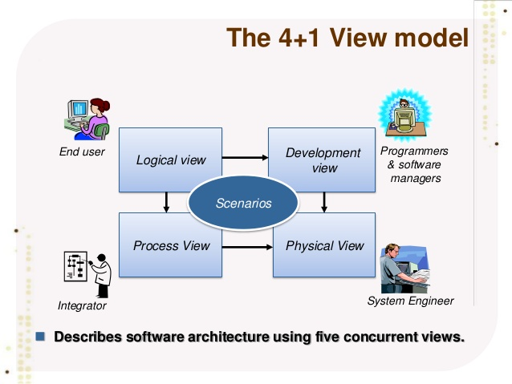

Slide 6
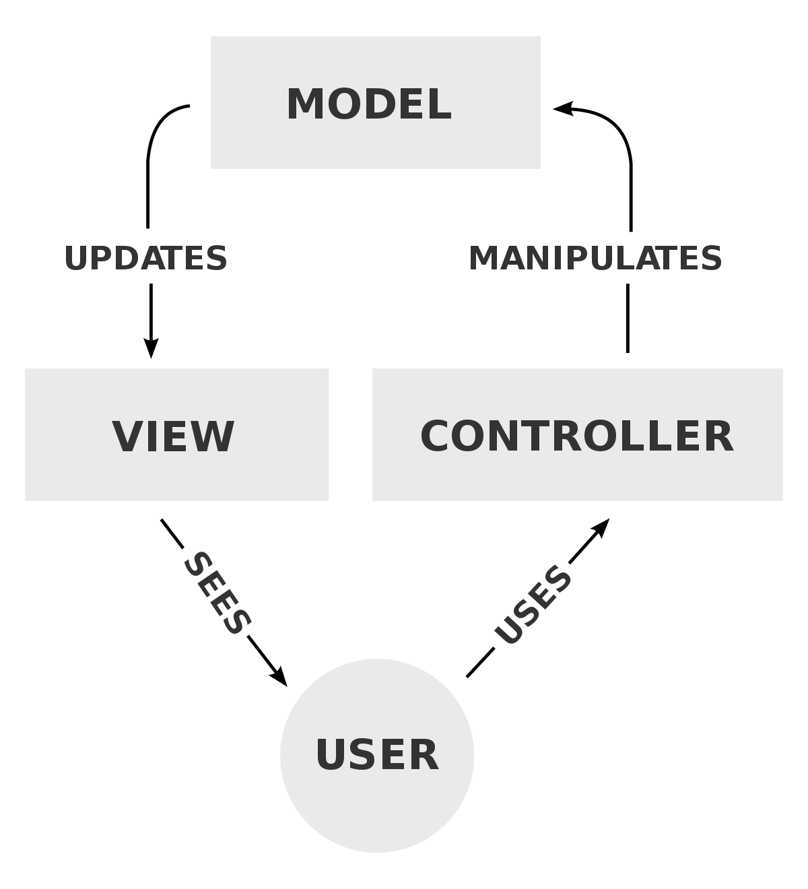
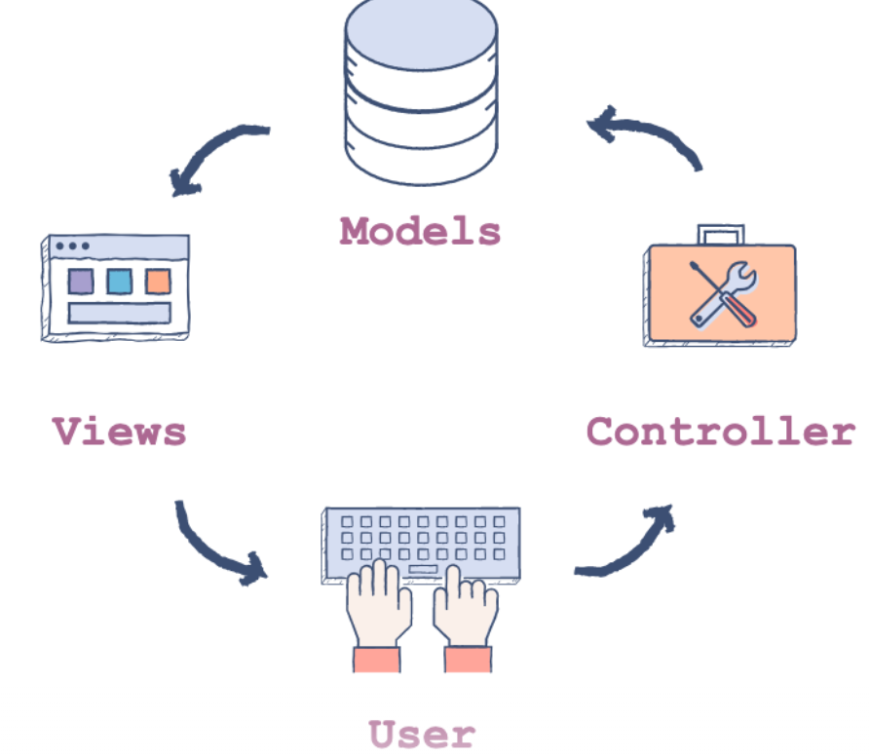
Model-View-Controller (MVC)
What is it? Separates the system into 3 parts:
Model – Manages data and logic
View – Displays the data (UI)
Controller – Handles user actions (input)
🖼️ Example: A shopping website:
Model: Product info, user accounts
View: Web pages showing products
Controller: Handles actions like "Add to Cart" or "Login"
✅ Why use it?
Easy to update UI without touching logic
Allows different views for same data (e.g., list view, grid view)

Slide 7
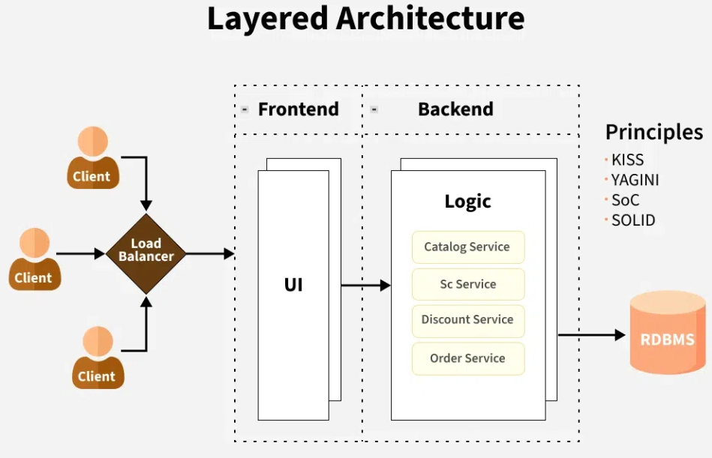
Layered Architecture
What is it? The system is divided into layers. Each layer provides services to the layer above it.
Example: An online banking system:
UI Layer: User interface
Business Layer: Manages transactions
Data Layer: Interacts with the database
✅ Why use it?
Easy to maintain and update
Each layer can be developed separately

Slide 8
Client-Server Architecture
🧩 What is it? Divides the system into clients (users) and servers (service providers).
🖼️ Example: ATM system:
Client: ATM machine
Server: Bank database and processing center
✅ Why use it?
Centralized control
Multiple clients can use the same services

Slide 9
Repository Architecture
🧩 What is it? All data is stored in a shared repository (central database), and components interact with it.
🖼️ Example: Integrated Development Environment (IDE):
Tools like editor, debugger, compiler all use the same project data
✅ Why use it?
All components share the same data
Easy to manage large volumes of data

Slide 10
Pipe and Filter Architecture
🧩 What is it? Data flows through a series of processing steps (filters). Each step modifies the data.
🖼️ Example: Invoice processing system:
Step 1: Read invoice → Step 2: Validate data → Step 3: Generate report
✅ Why use it?
Easy to reuse and add steps
Good for data processing or transformation tasks

Slide 11
An example of the pipe and filter architecture

Slide 12
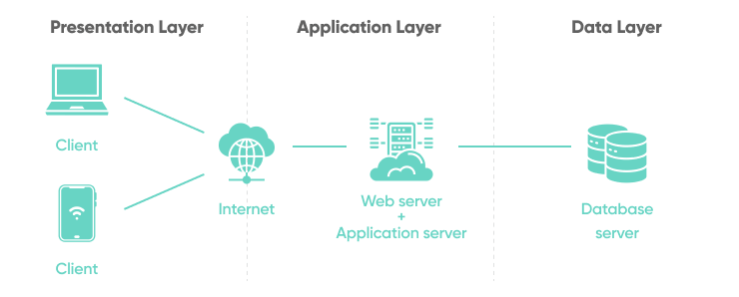
Web Application Architecture
The web application architecture describes the interactions between applications, databases, and middleware systems on the web.
It ensures that multiple applications work simultaneously. Let us understand it with a simple example of opening a webpage.
Example: visiting the website

Slide 13
How Does it work?
With any typical web application, there are two different codes (sub-programs) running side-by-side. These are:
Client-side Code - The code that is in the browser and responds to some user input
Server-side Code - The code that is on the server and responds to the HTTP requests

Slide 14
Quick Comparison Table
Pattern | Best For | Example
MVC | UI-based apps | Social media app
Layered | Clear separation of logic | Library system
Client-Server | Central services accessed by many users | ATM, Web apps
Repository | Shared data access | IDE, Management Systems
Pipe and Filter | Step-by-step data processing | Invoice system, Compiler

Slide 15
Application Architectures
Type | Description | Example
Transaction Processing | Handle user requests and database updates | ATM, Ticket Booking
Language Processing | Translate code | Java Compiler
Information Systems | Access large databases | Hospital system, Library catalog

Slide 16
Web-Based Information Systems
What is it?
A web-based system is an application that runs on the internet and is accessed using a web browser.
📦 Example: E-Commerce Website
An online store like Amazon:
Users browse products (UI in browser)
Add items to a shopping cart
Make payment in one final transaction

Slide 17
Architecture (Multi-tier Client-Server)
Web-based systems are usually split into 3 tiers:
Why use this? Keeps user interface, logic, and data separate Easier to manage and scale Each layer can be maintained independently
Tier | Role | Example
Web Server | Handles user interaction (UI) | Browser displays website
Application Server | Handles business logic | Adds items to cart, calculates total
Database Server | Stores and manages data | Stores product info, user details

